Slide 1

Causal Inference and ML Experiments
Rayid Ghani and Kit Rodolfa

Slide 2
Things to cover today
Final report and presentation reminders
Causal Inference 001
With Observational Data
Methods
Examples
Experiments
Standard Randomized Controlled Trials
Trial Design
Examples
Validating ML models/systems
Trial Design
Examples

Slide 3
Final Report and Presentation
Final Presentations:
Next week!
Tuesday: upload slides on canvas
Tuesday vs Thursday Preferences?
https://canvas.cmu.edu/courses/18465/assignments/268648
Final Reports:
Due Thursday, December 17
https://canvas.cmu.edu/courses/18465/assignments/268649

Slide 4
Scope
Data
Exploration
Modeling
Get Data
Store Data
Link Data
Rows
Features
Labels
Model Selection
Train-Test Splits
Performance Metrics
Model Interpretation
Entities
temporal
Spatial
…
Models
Dealing with Bias and Fairness
Field Trial Design
Deployment
Monitoring
Goals, Actions, Data, Analysis, Ethics

Slide 5
Class Recap
Scoping
Data Acquisition
Data Storage
Data Linkage
Data Exploration
Analytical Formulation
Modeling
Evaluation Metrics
Train Test Splits
Feature Generation
Baselines
ML Pipelines
Model Selection
Interpretability
Bias/Fairness
Field Trials
Deployment
Maintenance & Monitoring

Slide 6
Project checklist
Train Test Splits – make sure you’re using all of them
Features – make sure you have relevant features
Imputation
scaling
Models
Make sure you have an appropriately large grid and model types
Model Selection
Initial metric (sanity check with PR-k curve), and selection metric over time
Interpretability
Feature importances, Cross-Tabs
Bias
Protected Group and Bias Metric

Slide 7
Field Validation: Beyond A/B Testing
How well does the model perform in the real world?
Validation on truly unseen future data; only way to ensure against leakage
What key assumptions in our formulation need to be tested?
Are we intervening with the “right” people?
Are we intervening in the best way possible?
Impact of historical decision making / selective labels?
Most importantly: how well does the ML system we’re building help the organization realize its goals?

Slide 8
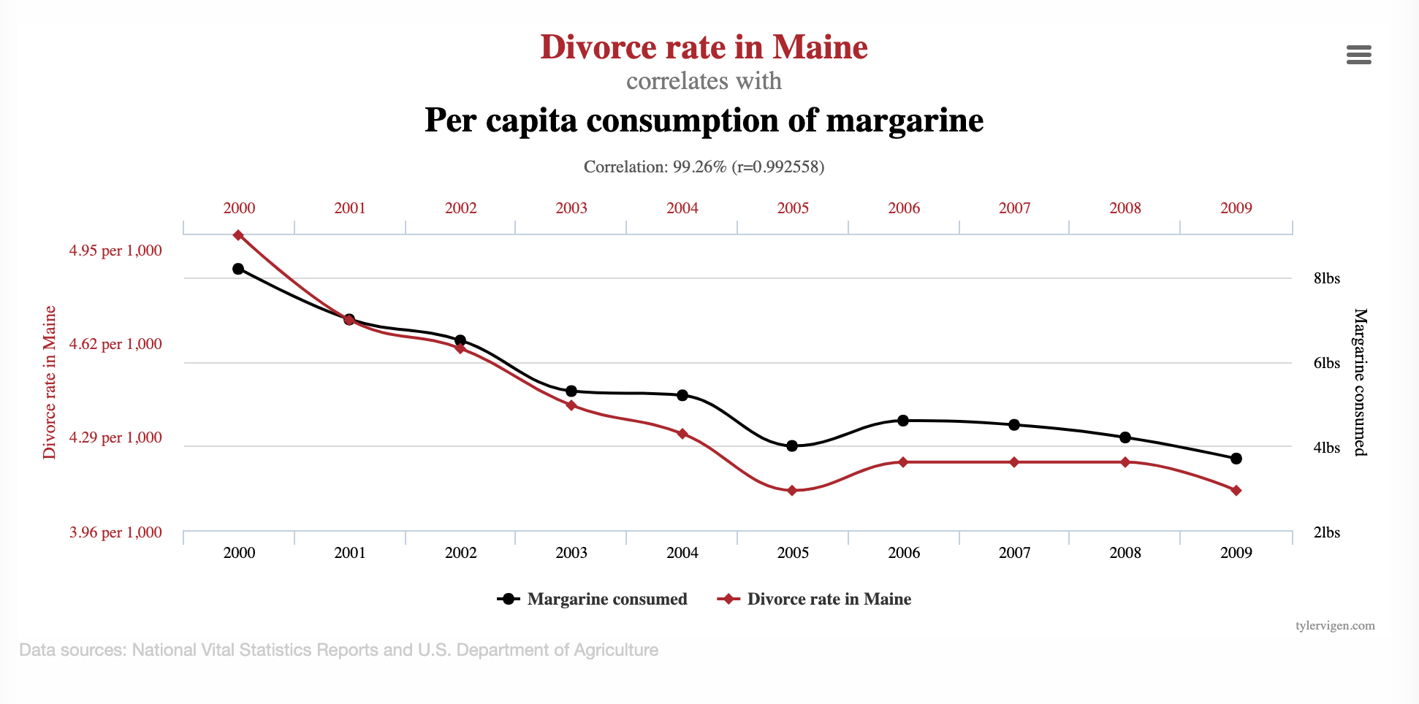
Goals of Causal Inference

Slide 9
Do sports programs affect school graduation rates?
sports programs
?
graduation

Slide 10
Do sports programs affect school graduation rates?
sports programs
Confounders
?
graduation

Slide 11
Do sports programs affect school graduation rates?
sports programs
Confounders
?
graduation
Examples?

Slide 12
Causal Research Design
Experiments
Quasi-experiments
Observational studies

Slide 13
Experiment
sports programs
Confounders
?
graduation
Researcher randomly assigns sports programs

Slide 14
Quasi-Experimental
sports programs
Confounders
?
graduation
Nature/World randomly assigns sports programs

Slide 15
Observational Study
sports programs
Confounders
graduation
Include confounders in regression

Slide 16
Methods for causal inference
Using Observational Data
Using Experiments

Slide 17
Causal inference with observational data
Matching
Difference-in-Difference (DID)
Regression Discontinuity Design (RDD)
Instrumental Variables
Limitations?

Slide 18
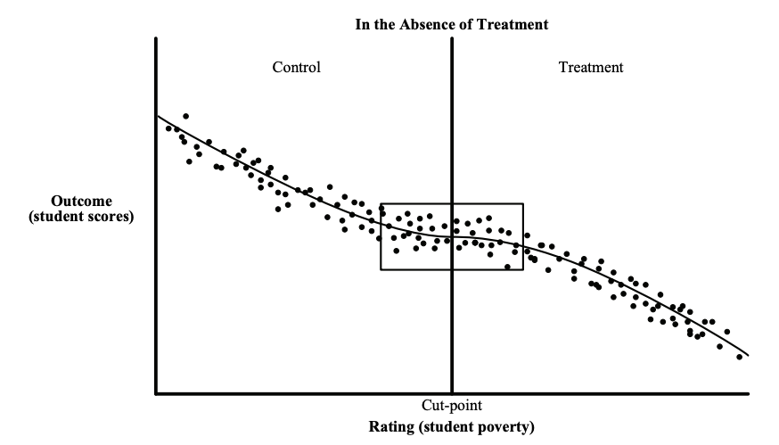
Causal inference with observational data
https://www.mdrc.org/sites/default/files/RDD%20Guide_Full%20rev%202016_0.pdf

Slide 19
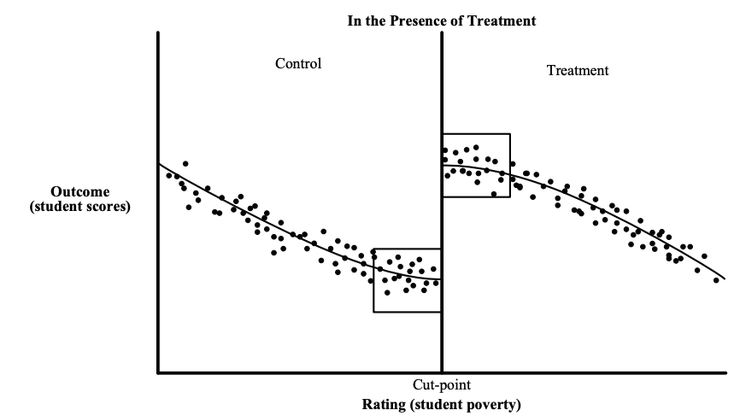
Causal inference with observational data
https://www.mdrc.org/sites/default/files/RDD%20Guide_Full%20rev%202016_0.pdf

Slide 20
Causal inference with experiments
Standard “Randomized Controlled Trials”
Trial Design
Outcome
Sample size
Power
Randomization
Ethical Concerns

Slide 21
Some things to keep in mind
Sample Size
Power Effect Size Significance Level
Effect size > what is practically useful and significant
Significance Level ~ cost of implementing the new system/model

Slide 22
Designing Trials to Validate ML Systems
What can we do with historical data?
Model Selection
Performance Estimation
How do we select the model to deploy?
Compare shortlisted models against baseline
How do we validate whether our ML system will work when deployed?

Slide 23
Designing an experiment
What are we trying to test?
How do we create different arms of the experiment?
How we do we run the experiment?
What do we measure?
How do we evaluate?

Slide 24
What are we testing in an experiment?
Lift?
Classification?
Probability estimates?
Ranking?
How does the experiment design change?

Slide 25
How many [students, inspections, projects] should we include in our trial?
Doing a trial over [y] years with [n] students every year will give us a [p%] chance to detect an [e%] increase in [outcome] with a statistical significance of [s%]

Slide 26
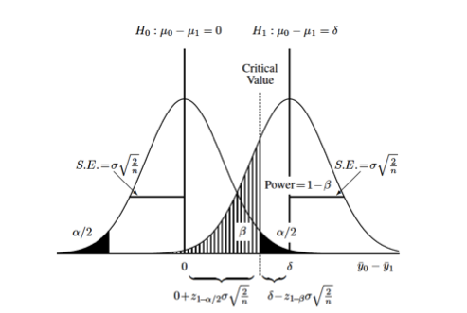
How many [students, inspections, projects] should we include in our trial?
https://clincalc.com/stats/samplesize.aspx

Slide 27
Some Readings
References on causal inference
The seven tools of causal inference, with reflections on machine learning by Pearl, J. Comm ACM. 2019
Elements of Causal Inference by Peters et al. MIT Press. (Open Access Text)
Counterfactuals and Causal Inference: Methods and Principles for Social Research by Morgan and Winship. Cambridge University Press.
Data Analysis Using Regression and Multilevel/Hierarchical Models by Gelman and Hill. Cambridge University Press.

